Slide 1
Unit II : Instrumental Methods of Analysis
Prof. Artee Shinde

Slide 2
Electrochemistry:
Is the branch of chemistry that deals with the chemical changes produced by electricity and the production of electricity by chemical change
Electrochemical processes are oxidation-reduction reactions in which:
The energy released by a spontaneous reaction is converted to electricity or electrical energy is used to cause a non- spontaneous reaction to occur.

Slide 3
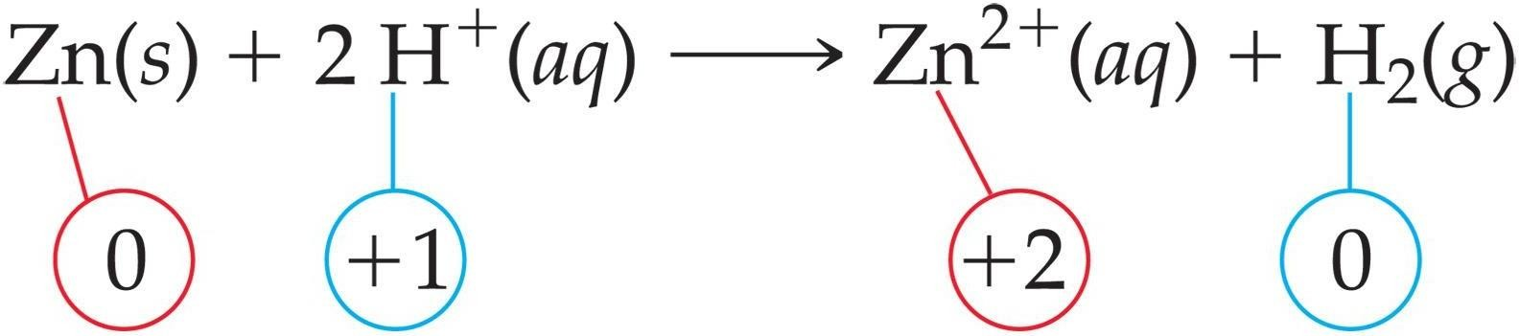
Oxidation-reduction
Oxidation is loss of e⁻ O.N. increases (more positive)
Reduction is gain of e⁻ O.N. decreases (more negative)
What is reduced is the oxidizing agent. H⁺ oxidizes Zn by taking electrons from it.
What is oxidized is the reducing agent. Zn reduces H⁺ by giving it electrons.

Slide 4
Cell
An electrochemical cell is a device capable of either deriving
electrical chemical energy.
energy from chemical reaction,
or facilitating of electrical
reactions through the introduction
A Cell consists of two electrodes (anode and cathode) in contact with an aqueous conducting medium.
Half Cell : An electrode in contact with aqueous conducting medium is known a half cell.

Slide 5
Types of cells
Voltaic (galvanic) cells:
a spontaneous reaction generates electrical energy
C. E. E. E.
Electrolytic cells:
absorb free energy from an electrical source to drive a non spontaneous reaction
E. E. C. E.

Slide 6
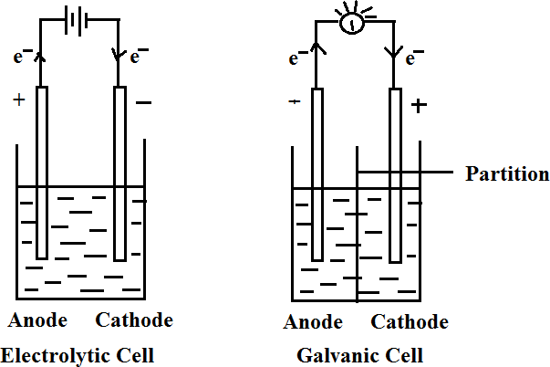
 | Electrolytic Cell |  | Galvanic / Voltaic Cell
 | Anode | Cathode | Anode | Cathode
Sign | + | - | - | +
Electron Flow | Out | In | out | in
Half Reaction | Oxidation | Reduction | Oxidation | Reduction

Slide 7
Common Components
Electrodes: conduct electricity between cell and surroundings
Anode: Oxidation occurs at the anode
Cathode: Reduction occurs at the cathode
Electrolyte: mixture of ions involved in reaction or carrying charge
Salt bridge: completes circuit (provides charge balance)

Slide 8
Galvanic Cells
The difference in electrical potential between the anode and cathode is called:
cell voltage/ electromotive force (emf)/ cell potential
Cell setup
Zn (s) + Cu²⁺ (aq) Cu (s) + Zn²⁺ (aq)
[Cu²⁺] = 1 M & [Zn²⁺] = 1 M
Zn (s) | Zn²⁺ (1 M) || Cu²⁺ (1 M) | Cu (s)
anode
cathode

Slide 9
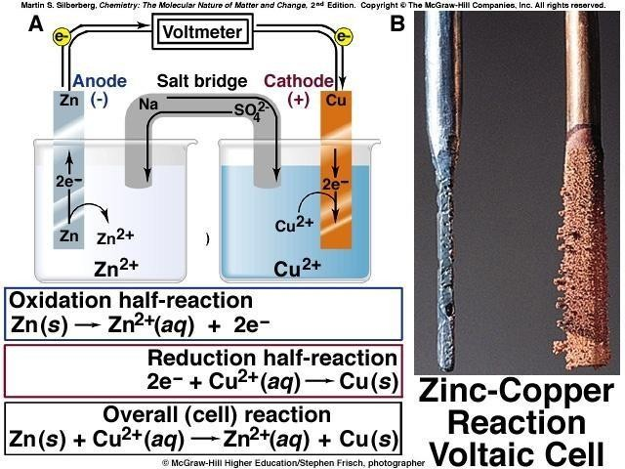
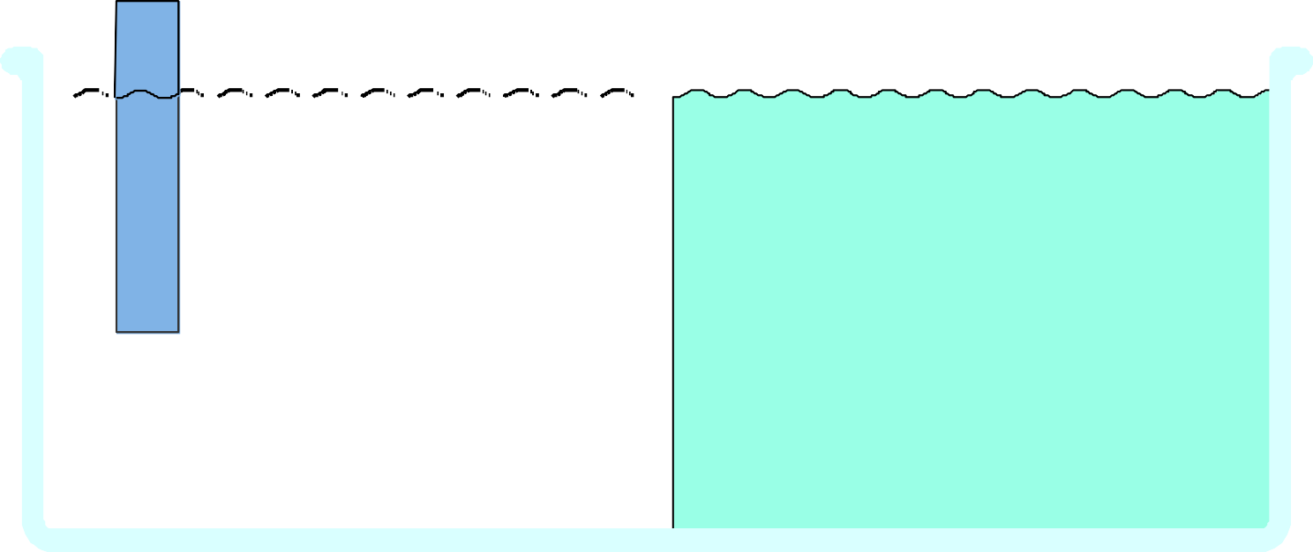
_{e} –
_{e} –
_{e} –
_{e} –
Porous disk
Oxidation
Reduction
_{e} –
Reducing agent
Oxidizing agent
_{e} –
(a) Anode
(b) Cathode

Slide 10
Representation of an electrochemical cell:
Anode (-ve electrode ) is written on left hand side and cathode (+ve electrode) is written on write hand side.
Single vertical line (l) or semicolon (;) indicates direct contact between two phases
ZnlZn⁺² or Cu⁺²lCu
The molar concentration is written in brackets after the formula of ion
ZnlZn⁺² (1M) or Cu⁺²(1M)lCu
Double standing line represents salt bridge to connect two half cells.
4) Cell representation :
Zn (s) + Cu²⁺ (aq) Cu (s) + Zn²⁺ (aq)
Zn (s) | Zn²⁺ (1 M) || Cu²⁺ (1 M) | Cu (s)

Slide 11
Electrode potential:
Electrode potential, E, in chemistry or electrochemistry, according to a IUPSC definition, is the electromotive force of a cell built of two electrodes:
on the left-hand side of the cell diagram is the standard hydrogen electrode (SHE), and
on the right-hand side is the electrode in question.
The SHE is defined to have a potential of zero Volt, so the signed cell potential from the above setup is
^{E}cell ^{= E}left (SHE) ^{− E}right ^{= 0 V − E}electrode ^{= E}electrode
.SHE is cathode and electrode is anode
^{ΔV}cell ^{= E}red,cathode ^{− E}red,anode
or, equivalently,
^{ΔV}cell ^{= E}red,cathode ^{+ E}oxy,anode.

Slide 12
Reference electrode:
Reference electrode is defined as the electrode which has stable and reproducible potential and completes the cell acting as half cell.
Purpose of reference electrode
to complete the cell
provide stable potential
returns to its original potential after being subjected to small currents
Types of Reference Electrodes
Standard hydrogen Electrode
Saturated Calomel Electrode

Slide 13
Difficulties in use of Standard Hydrogen Electrode
Platinum used in it get contaminated by impurities in solution and gases. Creates difficulty in attending equilibrium.
The presence of oxidising agents, unsaturated organic compounds etc in solution displaces the equilibrium and alters the potential.
It cannot be used frequently in presence of reducible ions or substances having +ve electrode potential such as Cu, Ag, Au etc.

Slide 14
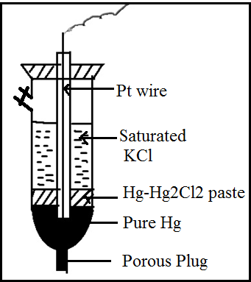

Calomel Electrode
Construction :
Calomel electrode consist of narrow glass tube at the bottom of which pure Hg is placed, above this there is a paste of Hg-Hg2Cl2. A remaining portion of glass tube is filled with saturated KCl solution.
Platinum wire is dipped in pure Hg to make electrical contact.
In a direct dipping type of calomel electrode there is a porous plug at the bottom .
Electrode representation

Slide 15
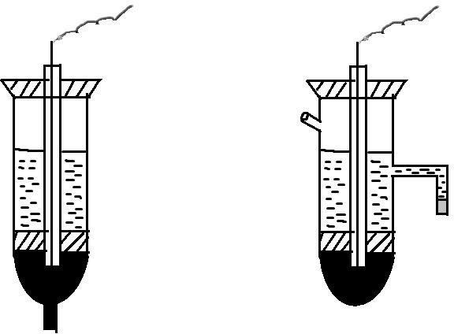
Calomel Electrode
Pt. wire
Saturated KCL
gel
Paste of Hg-Hg₂ Cl₂
Porous plug
Pure mercury
Porous plug

Slide 16
If calomel acts as cathode
If calomel acts as anode
The reduction electrode potential is given by
equation
= E° - 0.0591 log [ Cl¯]
^{E}cal
Potential of calomel electrode dependant on concentration of KCL
Concentration of KCl | E ° calomel | Name
0.1 N | 0.3334 volts | Desi normal calomel
1.0 N | 0.2810 volts | Normal calomel
Saturated | 0.2422 volts | Saturated calomel

Slide 17
Demerits of Calomel Electrode
can not be use above 50°C as Hg₂Cl₂ starts decomposing
involves handling of poisonous Hg and Hg2Cl2
Advantages :
less prone to contamination as Hg | Hg2Cl2 interface is protected inside a tube and is not in direct contact with electrolyte.
Reproducibility of Calomel electrode is much better than Ag | AgCl
Calomel – mineral rarely found in nature . Mercurous (I) chloride, Hg2Cl2.

Slide 18
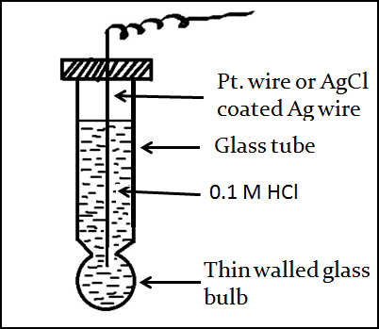
Indicator Electrode-Glass Electrode
Indicator Electrode – is the electrode of a cell in which the potential depends on the concentration of a particular ion .
Principle of Glass Electrode: When two solution of different H⁺ ions concentrations, are separated by a thin walled glass membrane, a potential difference developed is proportional to the difference in H⁺ ion concentration of the two solutions.

Slide 19
The glass electrode consists of a very thin walled glass bulb, made from a low melting glass having high electrical conductivity.
Electrode is filled with 0.1M HCl solution.
For external connection platinum (Pt) wire is insert.
Cell set up of glass electrode
The glass membrane acts as an ion exchanger i.e. exchange of Na⁺ of glass with H⁺ of solution.
Glass electrode require soaking of water for some hours before use so that –
surface becomes active,
hydrated layer developed on outer glass surface
Ion exchange can take place easily.

Slide 20
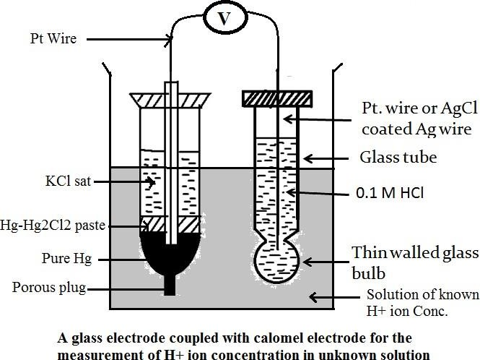
When glass electrode is placed in a sample solution containing unknown H+ ion concentration, the potential development across the glass membrane as a result of a concentration difference of H+ ions on both side of membrane.
Potential is determine by using saturated calomel electrode.

Slide 21

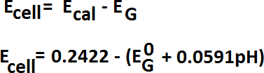

Determination of pH of Solution
A glass electrode is couple with the calomel electrode to determine the pH of the solution

Slide 22
Advantages of Glass Electrode
It is stable electrode and can be used in presence of strong oxidizing and strong reducing agents.
It is compact and portable.
It can be used in presence of biological fluids/ proteins.
It attained equilibrium quickly.
It can detect and estimate H⁺ ion in presence of other ions.

Slide 23
Ion-Selective Electrode (ISE)
A membrane of a half cell is sensitive to particular ion in solution and ion exchange takes place between the membrane and the solution containing specific ions and develops a potential which depends upon the concentration of that ion.
The potential develop at the ion sensitive sensor is a measure of concentration of the ions of interest.
An ion-selective electrode (ISE), also known as a specific ion electrode (SIE), is a transducer (or sensor) that converts the activity of a specific ion dissolved in a solution into an electrical potential.
e.g. H+ sensor (glass electrode) ; Ca++ (sensor Calcium ISE)
It is also called chemical sensors.

Slide 24
Advantages of Ion selective electrodes
Ion selective electrode detect and measure the concentration of ion in the solution.
Relatively inexpensive and simple to use
Durable in field and laboratory environment.
Can be use for coloured and turbid samples.
Can be use over wide range of temperature.
Mechanically strong.
Show resistant to solvent and chemical attack.
ISEs widely used for chemical, environmental, clinical, pharmaceutical food analysis.
Based on type of membrane, Ion – selective electrodes can be classified into various types
Glass membrane electrode
Solid – State membrane Electrode
Enzyme based membrane / Biochemical electrode
Gas Sensing electrode
Liquid-liquid membrane electrode

Slide 25
Pollution Monitoring: CN, F, S, Cl, NO3 etc., in effluents, and natural waters.
Agriculture: NO3, Cl, NH4, K, Ca, I, CN in soils, plant material, fertilizers and feedstuffs.
Food Processing: NO3, NO2 in meat preservatives.
Salt content of meat, fish, dairy products, fruit juices, brewing solutions.
F in drinking water and other drinks.
Ca in dairy products and beer.
K in fruit juices and wine making.
Corrosive effect of NO3 in canned foods.
Detergent Manufacture: Ca, Ba, F for studying effects on water quality.
Paper Manufacture: S and Cl in pulping and recovery-cycle liquors.
Explosives: F, Cl, NO3 in explosive materials and combustion products.
Electroplating: F and Cl in etching baths; S in anodising baths.
Biomedical Laboratories: Ca, K, Cl in body fluids (blood, plasma, serum, sweat).
F in skeletal and dental studies.
Education and Research: Wide range of applications.

Slide 26
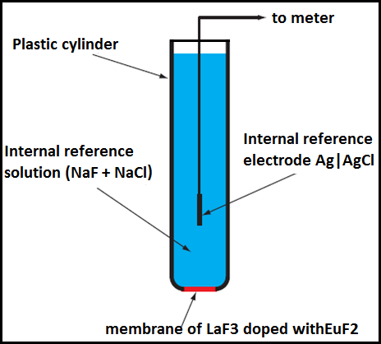
2. Solid – State Electrode
This is based on an inorganic crystal doped with a small amount of ions of a different vacancy to create vacant sites.
Examples 1) Fluoride ISE 2) Chloride ISE
1) Fluoride ISE -For instance, in a F¯ ion electrode, a LaF3 (Lanthanum fluoride) crystal is doped with EuF2 Europium fluoride) so that there are anion vacancies for the migration of F¯ through the LaF3 crystal.
Crystal is sealed at the bottom of the polymeric container containing internal reference solution (NaF + NaCl or KF + KCl) and consisting of reference electrode
Use for the determination of F¯ in water.

Slide 27
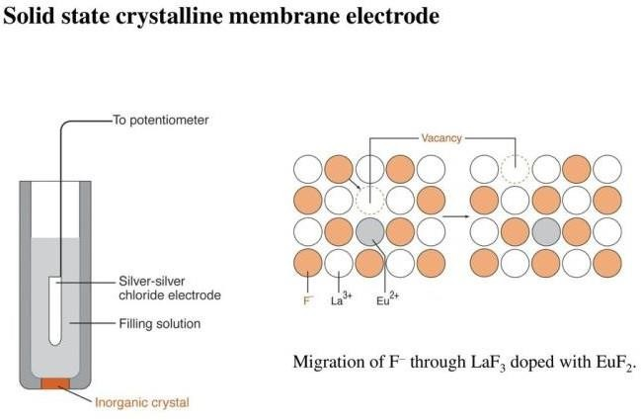
Working of Fluoride ion electrode
EuF2 produce holes in the crystal lattice of LaF3 through which F¯ ion can pass.
When the electrode is in contact with the sample solution a potential develops across the membrane which depends on the differences of F¯ concentration on either side of the membrane.
Since the internal F¯ ion conc. Is fixed, the potential developed across the membrane is related to the F¯ ion conc in the sample solution
LaF₃ ↔ LaF⁺₂+ F⁻
Fluoride ion electrode: e.g.
Internal electrode- Ag-AgCl electrode Filling Solution – (NaCl + NaF) aqueous
Membrane – LaF3 doped with EuF2 crystal disc
Application : Electroplating industry, water treatment, Toothpaste

Slide 28
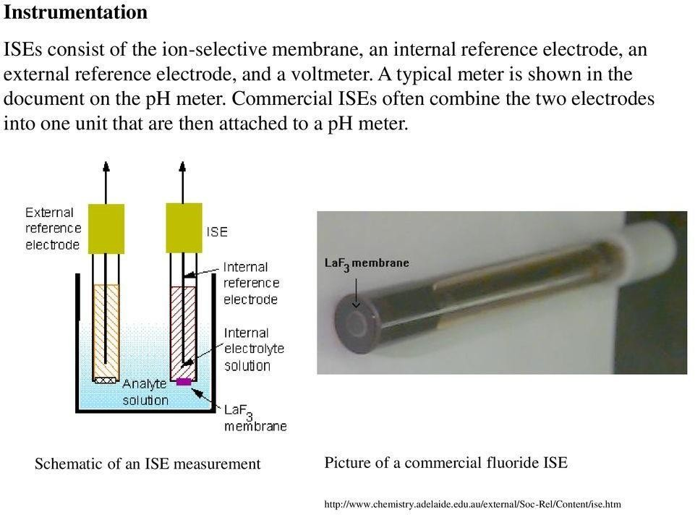

Slide 29
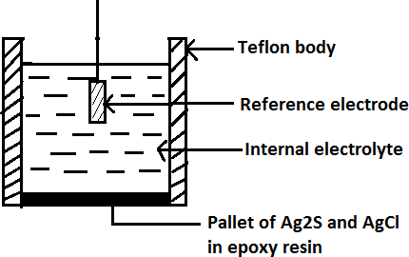
2) Chloride ion selective electrode – Solid state electrode
Electrode is made up of teflon and the Pallet of Ag2S and AgCl is attached using epoxy resin.
When electrode membrane is in contact with a solution containing chloride ions, an electrode potential develops. This potential is measured using reference electrode.

Slide 30

Conductometry
The ability of any ion to transport charge depends on the mobility of the ion. Mobility of ion is affected by factors like- charge on ion, size and mass of ion , extent of solvation
Ohm’s Law:
Ohm’s law state that the current (I) flowing through the conductor is directly proportional to the potential difference (V) applied across the conductor and inversely proportional to the electrode resistance (R) of the electrode.
Where I is the current in ampere V – potential difference in volts R – Resistance in ohm
Ohm’s law is obeyed by metallic conductor and electrolyte solution

Slide 31
Electrolytes-
substances on dissolution forms +ve and –ve ions
Substances whose solution in water conducts electric current.
Conduction takes place by the movement of ions. Examples are salts, acids and bases.
Non electrolytes- substances on dissolution does not forms +ve and –ve ions
Substances whose aqueous solution does not conduct electricity are called non electrolytes.
Examples are solutions of cane sugar, glucose, urea etc.

Slide 32




Conductance (C) – is the ease with which current flows through the conductor or solution and is reciprocal of resistance
C - ohm⁻¹ or mho
Specific resistance (ρ)- The resistance R of a conductor at a definite temperature, is directly proportional to its length (l) and inversely proportional to the area of cross section (A)
Resistance of any uniform conductor is
A
l

Slide 33


ρ is specific resistance, if l = 1cm , and A = 1cm² then
R = ρ
•

Slide 34


Specific resistance of a substance is defined as the resistance offered by a cube of length 1cm and area of cross section A, 1cm2, to passage of electricity through it.
Hence unit of ρ is ohm.cm

Slide 35


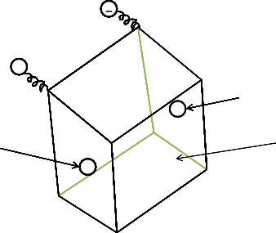
Specific Conductance (K):
The specific conductance of any conductor is the reciprocal of sp. Resistance.
Sp. Conductance of a solution can be defined as the conductance of solution between two parallel electrodes which have cross section area 1 cm2 and which re kept 1cm apart.
-
+
-
anode
Unit of Sp. Conductance ohm⁻¹.cm⁻¹
Cathode
Solution
+
Specific conductance depend on the number of ions present in unit volume (1 ml ) of solution

Slide 36



Cell Constant: The ratio of l/A is known as cell constant. It depends upon the distance between the electrode (l) and the area of cross section (A) of the electrode.
From equation

Slide 37
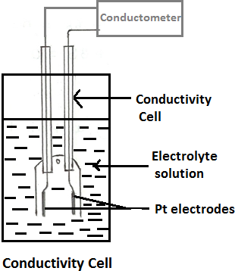
Conductivity Cell:
In conductance measurement conductivity cell is used
For conductance measurement AC current is used.
Conductance is measure with the help of Wheatstone bridge circuit.
Conductivity cell is made up of two Pt electrodes coated with Platinum black to avoid the polarization effect.

Slide 38
Determination of cell constant:
To determine the cell constant, a standard solution of KCl whose specific conductance at a given temperature is known is used. Then the standard KCl of same concentration is prepare and its conductance is measured at same temperature.
N/50 KCl -0.372 gm KCl in 250 ml conductivity water , conductance at 25°C is 0.002765 mho.

Slide 39





Equivalent conductance: is defined as the conductance of a solution containing one gram equivalent of an electrolyte at any particular concentration, when placed between two electrodes 1 cm apart.
The volume per gram equivalent of electrolyte is called as dilution factor of the solution.
If concentration of the solution is ‘C’ grams per lit, then the volume containing 1 gram equivalent of electrolyte will be

Slide 40





Molar Conductance:
Molar conductance of an electrolyte is the conductance of solution containing 1 mole of the electrolyte, when placed between two electrode 1 cm apart.

Slide 41
Factors affecting conductivity
Number of ions per ml- greater the number of ions per ml in a solution, greater is the specific conductance. At higher concentration of the solution, the number of ions per ml is higher.
Concentration – in case of weak electrolytes as concentration decreases i.e. is dilution increases the number of ions increases and equivalent conductance increases, although specific conductance decreases.
Mobility of ions – smaller the size of ion greater is its mobility e.g. H+ ion.
Charge on ion – higher is the charge on ion greater is its mobility. e.g. Mg⁺⁺ > Na⁺ ; SO4⁻² > NO3⁻
Temperature – at higher temperature K.E. increases, viscocity decreases, interaction between ions decreases therefore conductance increases

Slide 42
Conductometric Titration Curves
Conductometric Titration:
The titration in which conductance measurement are used to determine the equivalence point of the titration called as conductometric titration.
1) Strong Acid with Strong Base
e.g. HCl with NaOH (In burette NaOH and in conical flask HCl)
Reaction
At the Initial Stage of Titration: Since HCl being strong acid, dissociate completely to produce H+ and Cl- . H+ ions are small in size and shows highest mobility. Therefore in the beginning for zero ml addition of NaOH conductance is highest.
Before equivalence point: During titration on addition of NaOH from burette in HCl in beaker, HCl is under going neutralization , and concentration of H+ decreases and therefore condutance decreases upto equivalence point.
HCl → H⁺ + Cl⁻

Slide 43
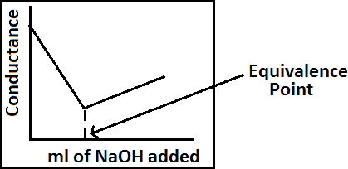
At equivalence point conductance is minimum due the formation of salt NaCl, which is dissociating completely.
After equivalence point: On further addition of NaOH conductance increases due to OH- ions
Calculation :
1000 ml 1N NaOH = 36.5 gm HCl
1 ml 1N NaOH = 36.5 mg HCl
Curve Explanation:
Initial stage
Before equivalence point
At the equivalence point
After equivalence point

Slide 44
Applications :
1. Check water pollution in rivers and lakes
2. Alkalinity of fresh water
3. Salinity of sea water (oceanography)
4. Deuterium ion concentration in water- deuterium mixture
5. Food microbiology- for tracing micro organisms
6. Tracing antibiotics
7. Estimate ash content in sugar juices
8. Purity of distilled and de - ionised water can determined
9. Solubility of sparingly soluble salts like AgCl,BaSo4 can be detected
ADVANTAGES OF CONDUCTOMETRIC TITRATIONS No need of indicator Colored or dilute solutions or turbid suspensions can be used for titrations. Temperature is maintained constant throughout the titration. End point can be determined accurately and errors are minimized as the end point is being determined graphically.

Slide 45
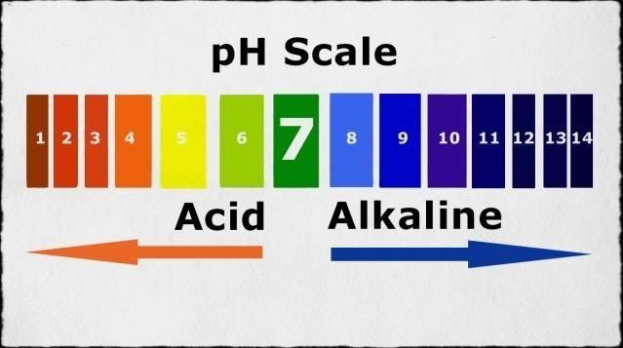
pH metry
The term pH was introduce by Sorensen in 1909.
pH = - log [H⁺]
Buffer Solution : two types
1. Acidic buffer : WA with a salt of WA and SB
e.g. CH3COOH + CH3COONa
Na2HPO4 + citric acid [C6H8O7]
2. Basic Buffer: WB with a salt of WB and SA
e.g. NH4OH + NH4Cl

Slide 46
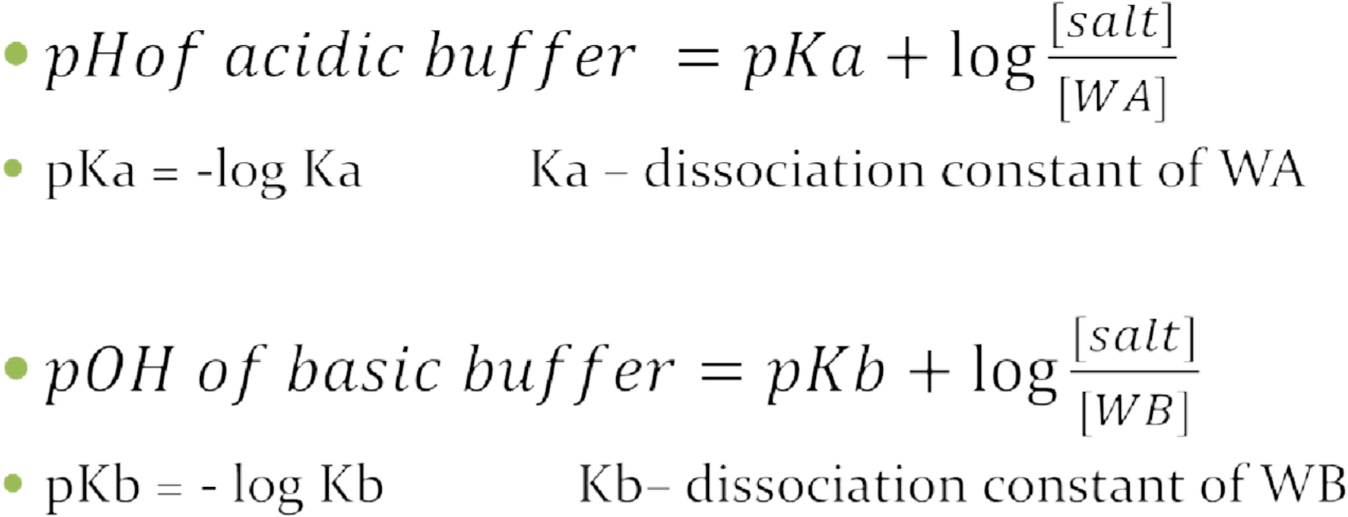
From Handerson equation buffer solution can be prepared
⚫

Slide 47


The relationship between the pH of а solution and the concentrations of an acid and its conjugate base is easily derived.
[НА]
[Н⁺]= K ----------
[А⁻]
Taking the negative log of each term
[А⁻]
рН = - log К + log ---------
[А⁻]
This relationship known as the Henderson equation, that is often used to perform the calculations required in preparation of buffers for use in the laboratory, or other applications.

Slide 48
Measurement of pH :
pH meter is used to determine pH of the solution
Calomel electrode is used as reference electrode and glass electrode is used as indicator electrode.
Importance of pH metric titration:
Equivalence point of acid –base titration can be determine accurately by pH metric titration.
In pH metric acid-base titration indicator is not needed.
Instrument used is simple and easy to handle
• pH Meter Applications: is very crucial in Agriculture industry for soil evaluation. • To know the pH of buffer solution • To measure the pH of rainwater • It becomes mandatory for chemical and pharmaceutical industries • pH meter is used in brewing industry. • It is also used in jam and jelly manufacturing • It becomes a significant factor in the production of detergents. • It is used for monitoring water in swimming pools • pH meter helps in analyzing the exact pH value of chemical substances and food grade products, thus ensuring high levels of safety and quality.

Slide 49
pH metric titration between HCl and NaOH
Consider the titration between HCl and NaOH
As HCl is strong acid and NaOH is strong base, dissociates completely. HCl + NaOH → NaCl + H2O
Procedure:
Standardization of pH meter: pH meter is standardized using buffer solutions with pH 4, 7 and 9.2.
HCl is taken in beaker and NaOH in burette.
Acid – Base Titration :
Take a known volume of HCl in a beaker.
Immerse the glass electrode (indicator electrode) and Calomel electrode (reference electrode) in it. Note the pH for zero mL addition of NaOH.
Fill the burette with known concentration of NaOH.
Every time add 0.5 ml NaOH in acid solution, stir the solution and note down the pH.
Continue the titration, at the equivalence point pH suddenly increases. After sudden increase in pH, do the few addition of NaOH till pH remains constant.

Slide 50
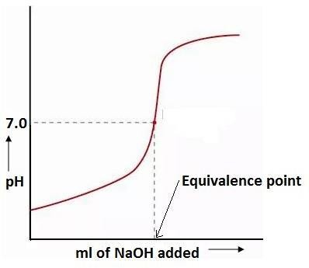
Graphs: 1) Plot the graph of pH verses mL of NaOH added
Initial stage: at the initial stage of titration pH reading is between 1-2 pH due to complete dissociation of HCl. HCl → H+ + Cl-
Before equivalence point: with the addition of NaOH from burette HCl is getting neutralization, and H+ ion concentration decreases therefore slowly pH increases up to equivalence point.
At the equivalence point : at the complete neutralization of HCl, pH of solution is 7
After equivalence point: with further addition of NaOH pH increases, after that for the addition of NaOH it remains constant dure to complete dissociation of NaOH.

Slide 51
Observation :
From the graph equivalent point of titration is noted as X ml i.e. 0.1 N NaOH required for neutralization of HCl taken
Calculation:
N = N2V2/ V1
Normality of HCl can be calculated

Slide 52
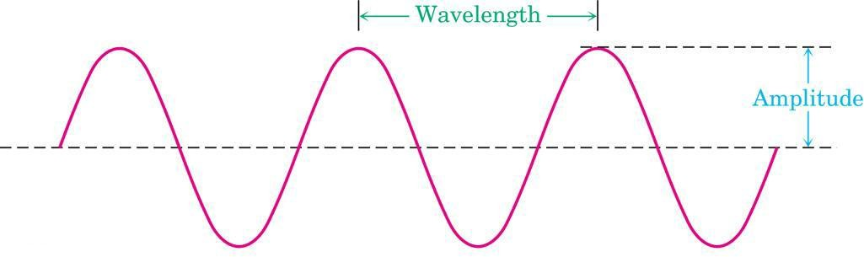
Spectroscopy
Spectroscopy is the branch of science that deals with the study of interaction of electromagnetic radiation with matter.
Spectroscopic methods of analysis are based on measurement of the electromagnetic radiation emitted or absorbed by the sample.
Spectroscopy is the interaction of EMR with matters to get spectra ,which gives information like, bond length, bond angle, geometry and molecular structure.
Electromagnetic radiation displays the properties of both particles and waves. The
particle component is called a photon.
Where h is Planck’s constant and ʋ is the frequency in Hertz (cycles per second) .
ν = frequency: waves per unit time (sec-1, Hz)
λ = distance of one wave

Slide 53
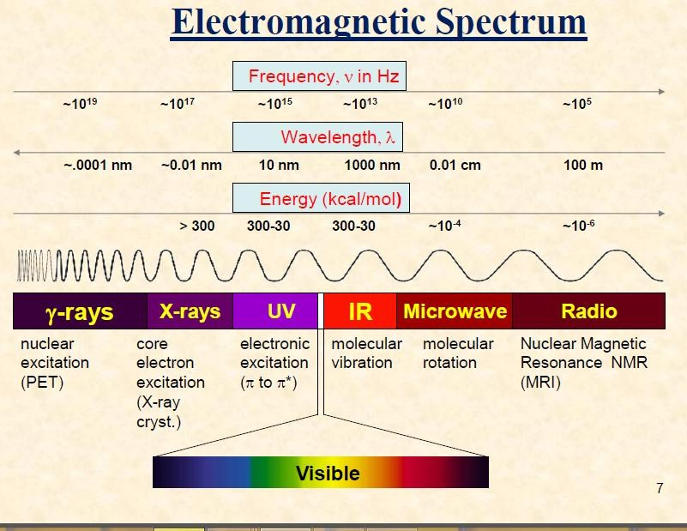

Slide 54
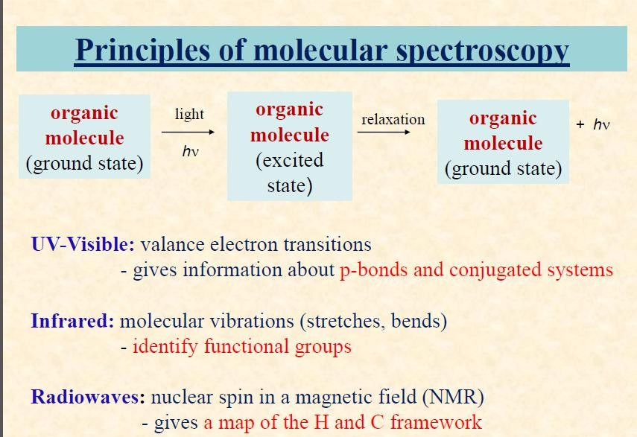
Instrument used to measure the absorbance in UV (200- 400nm) or Visible (400-800nm) region is called UV- Visible Spectrophotometer.

Slide 55


Lambert’s law
When a monochromatic radiation is passed through a solution decrease in intensity of incident light with thickness of solution is directly proportional to the intensity of incident radiation

Slide 56
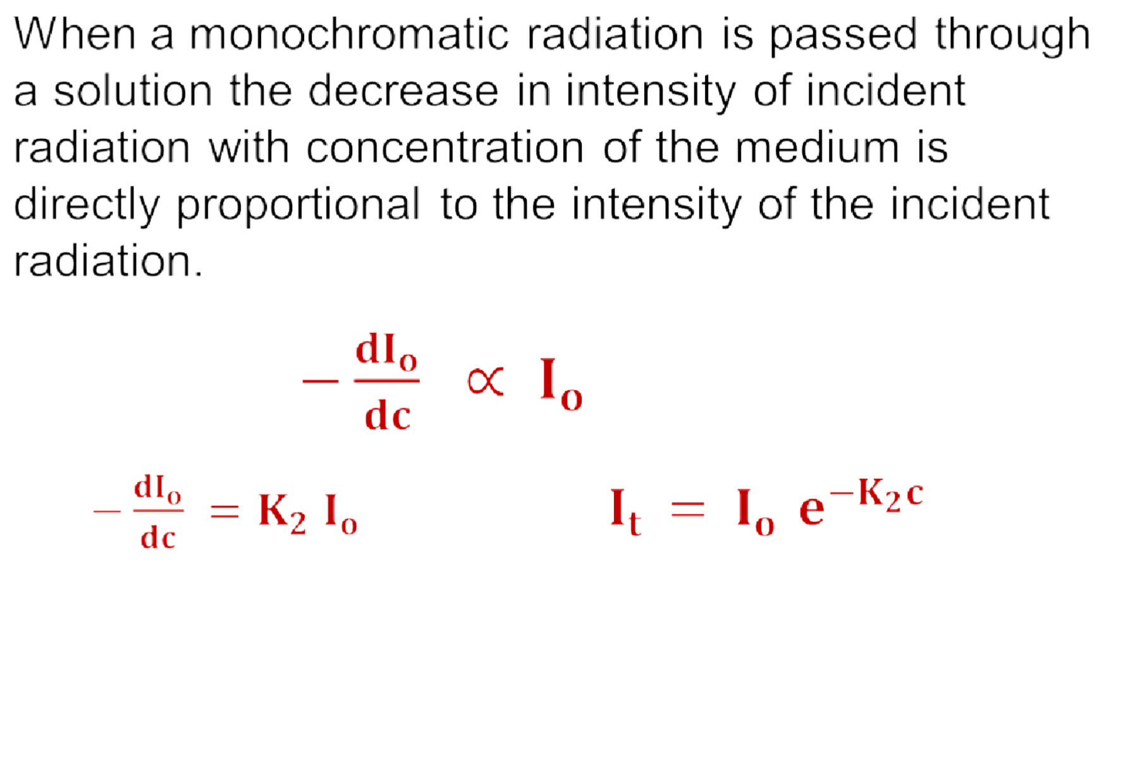
Beer’s law

Slide 57


Combine Beer-Lambert’s law
K is absorptivity constant when c is in gm/lit and x in cm
If concentration is express in moles/ lit then
ϵ is molar absorptivity or molar extinction coefficient

Slide 58




Slide 59
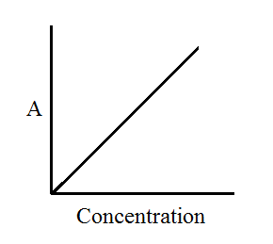
Varification of Beer-Lambert’s law
Absorbance vs concentration ( thickness of medium is fixed )

Slide 60
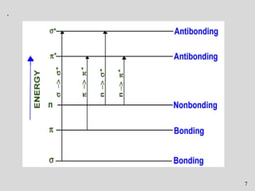
Electronic transition
The order of energy required for electronic transition is
σ → σ∗ >π →π* > n→σ* > n → π*
σ → π* and π →σ* transitions are forbidden

Slide 61
σ→ σ* transition: An electron in a bonding s-orbital is excited to the corresponding anti-bonding orbital and observed with saturated compounds. The energy required is large. For example, methane (which has only C-H bonds, and can only undergo σ→ σ* transition transitions) shows an absorbance maximum at 125 nm. Absorption maxima due to σ→ σ* transition are not seen in typical UV-VIS spectra (200 - 700 nm) but in UV-region (125- 135nm).
2. n → σ* transition: Saturated compounds containing atoms with
lone pairs (non- bonding electrons) like O, N, S and halogens are
capable of n→ σ* transition. These transitions usually need less
energy than σ → σ* transition. They can initiated by light whose
wavelength in range 150 -250 nm. The number of of organic
functional groups with n → σ* peaks in the UV region is small.

Slide 62
3. π→ π* transition: π electron in a bonding orbital is excited to corresponding anti- bonding orbital π* and observed in conjugated compounds. Compounds containing multiple bonds like alkenes, alkynes, carbonyl, nitriles, aromatic compounds, etc undergo π → π* transitions. e.g. Alkenes generally absorb in the region 170 to 205nm.
4. n → π* transition: An electron from non-bonding orbital is promoted to anti- bonding π* orbital and required lower energy. Compounds containing double bond involving hetero atoms (C=O, C≡N, N=O) undergo such transitions. n → π* transitions require minimum energy and show absorption at longer wavelength around 300 nm

Slide 63
Terms involve in UV –Visible spectroscopy
Chromophore - The functional groups containing multiple bonds capable of Absorbing radiations above 200 nm due to n→π* & π→π* transitions. e.g. NO2, N=O, C=O, C=N, C≡N, C=C, C=S, etc Any substance (groups) which absorbs radiation at particular wave length this may or may not impart colour to the compound. Chromophor.
Auxochrome: The functional groups attached to a chromophore which modifies the ability of the chromophore to absorb light , altering the wavelength or intensity of absorption. e.g. Benzene λmax=255 nm, Phenol λmax=270 nm, Aniline λmax=280 nm

Slide 64
3)Bathochromic shift (Red Shift)
When absorption maxima (λmax ) of a compound shifts to longer wavelength it is known as bathochromic shift or red shift.
This is due to the presence of auxochrome or change of solvent.
E.g. auxochrome group like –OH, -OCH3

Slide 65
In alkaline medium, p-nitrophenol shows red shift. Because negatively charged oxygen delocalizes more effectively than the unshared pair of electron.
O
_{O}- _{O}-
+
O
+
N
N
•
OH⁻
+ H+
Alkaline
medium
_{O}-
OH
p-nitrophenol λ_{max} = 255 nm
p-nitrophenoxide ion λ_{max} = 265 nm

Slide 66
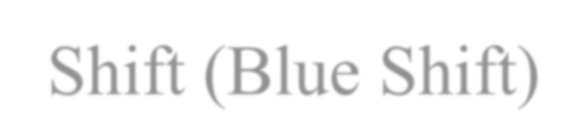

Hypsochromic Shift (Blue Shift)
Shift of absorption maximum towards shorter wavelength. caused by removal of conjugation Eg: In Aniline, absorption takes place at 280nm. In acidic solutions, absorption takes place at 200nm
+_{Cl}-
NH
2
+
NH
3
H
Acidic medium
Aniline
λ_{max} = 280 nm
λ_{max} = 265 nm

Slide 67


Hyperchromic Effect
When absorption intensity (ε) of a compound is increased, it is known as hyperchromic shift.
If auxochrome introduces to the compound, the intensity of absorption increases.
N
N CH₃
2-methyl pyridine λ_{max} = 260 nm
ε = 3560
Pyridine
λ_{max} = 257 nm
ε = 2750

Slide 68


Hypochromic Effect
When absorption intensity (ε) of a compound is decreased, it is known as hypochromic shift.
CH₃
2-methyl naphthalene
ε = 10250
Naphthalene
ε = 19000

Slide 69
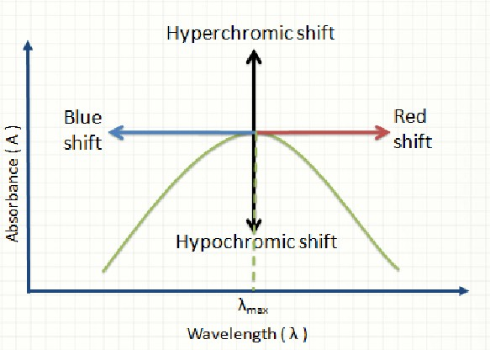
Shifts and Effects

Slide 70
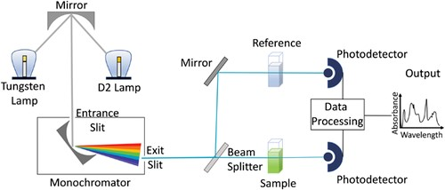
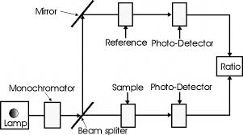
Double Beam Spectrophotometer
Block Diagram

Slide 71
Instrumentation :
1) Source
2) Monochromators
3) Sample holders/cuvettes
4) Detector
5) Recorder
1) LIGHT SOURCE Requirements: It should be stable. It should provide continuous radiation . It must be of the sufficient intensity for the transmitted energy to be detected at the end of the optical path. TYPES OF LAMP : 1) HYDROGEN DISCHARGE LAMPS 2) DEUTERIUM LAMPS 3) TUNGSTEN LAMP 4) XENON DISCHARGE LAMP 5) MERCURY ARC LAMP
1.HYDROGEN DISCHARGE LAMP It is a continuous source. Covers a range 160-375nm. Stable and widely used. PROCESS 1) High voltage current is passed through the electrodes 2) Discharge of electrons occurs 3) Excitation of hydrogen molecules 4) Cause emission of UV radiation.

Slide 72
2. DEUTERIUM LAMPS Similar to hydrogen discharge lamp. Deuterium is filled in place of hydrogen. The intensity of radiation emitted is 3 to 5 times the intensity of a hydrogen lamp. More expensive than hydrogen lamp. Used when high intensity is required.
3. TUNGSTEN LAMP Continuous source of light. When tungsten filament is heated by an electric current ,the light is produced. The glass bulb enclosing the filament contains a low pressure of inert gas, usually argon.
MIRRORS:
These are used to reflect, focus light beams in spectrophotometer. To minimize the light loss, mirrors are aluminized on their front surfaces.

Slide 73
2. MONOCHROMATORS It is used to disperse the heterochromic radiation into its component wavelength. It consists of an entrance slit, an exit slit and a dispersing device either a prism or grating. For eg :Quartz for ultraviolet.
PRISM Made up of glass , quartz or fused silica. When white light is passed through the glass prism, dispersion of polychromatic light in rainbow occurs . Now by the rotation of the prism different wavelengths of the spectrum can be made to pass through in exit slit on the sample. The effective wavelength depends on the dispersive power of prism material and the optical angle of the prism.

Slide 74
4) SLITS:
Slit is an important device in resolving polychromatic radiation into monochromatic radiation. To achieve this, entrance slit and exit slit are used. The width of slit plays an important role in resolution of polychromatic radiation.
5) SAMPLE HOLDER/ CUVETTES:
The cells or cuvettes are used for handling liquid samples. For study in UV region the cells are prepared from quartz or fused silica Cleaning is carried out washing with distilled water or with dilute alcohol, acetone. The surfaces of absorption cells must be kept scrupulously clean. No fingerprints or blotches should be present on cells

Slide 75
6) DETECTORS
Device which converts light energy into electrical signals, that are displayed on readout devices. The transmitted radiation falls on the detector which determines the intensity of radiation absorbed by sample. The followed types of detectors are employed in instrumentation of absorption spectrophotometer.1 Photovoltaic cell 2. Phototubes tube 3. Photomultiplier tube Requirements of ideal detectors: It should give quantitative response. It should have high sensitivity and low noise level. It should have a short response time. It should provide signal or response quantitative to wide spectrum of radiation received
7) AMPLIFIER AND RECORDER
Amplifier amplifies signal coming from detector ▪ Recorder records them which is displayed on readout device.

Slide 76
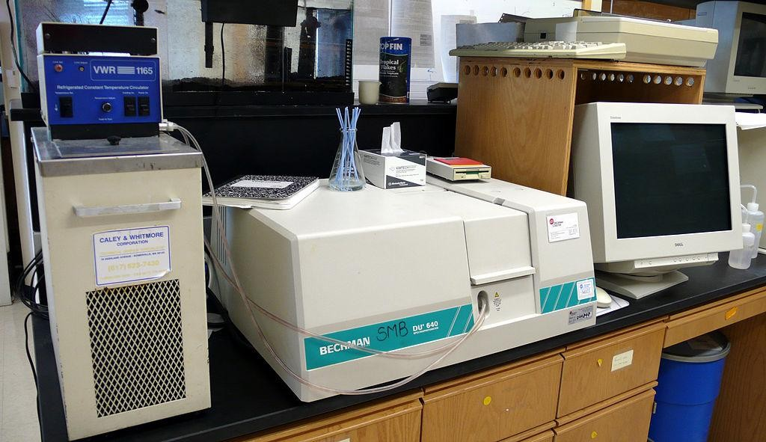

Slide 77
APPLICATIONS OF U.V. SPECTROSCOP
1. Detection of Impurities:
UV absorption spectroscopy is one of the best methods for determination of impurities in organic molecules. Additional peaks can be observed due to impurities in the sample
2 Structure elucidation of organic compounds.
UV spectroscopy is useful in the structure elucidation of organic molecules, the presence or absence of unsaturation, it can be concluded that whether the compound is saturated or unsaturated, hetero atoms are present or not etc.
3. QUANTITATIVE ANALYSIS
UV absorption spectroscopy can be used for the quantitative determination of compounds that absorb UV radiation. This determination is based on Beer’s law .
4.QUALITATIVE ANALYSIS
UV absorption spectroscopy can characterize those types of compounds which absorbs UV radiation. Identification is done by comparing the absorption spectrum with the spectra of known compounds.

Slide 78
5. CHEMICAL KINETICS
Kinetics of reaction can also be studied using UV spectroscopy. The UV radiation is passed through the reaction cell and the absorbance changes can be observed.
6. DETECTION OF FUNCTIONAL GROUPS This technique is used to detect the presence or absence of functional group in the compound Absence of a band at particular wavelength regarded as an evidence for absence of particular group
7. QUANTITATIVE ANALYSIS OF PHARMACEUTICAL SUBSTANCES Many drugs are either in the form of raw material or in the form of formulation.

